Slide 1
Chapter 6: Process Synchronization

Slide 2
Objectives
To introduce the critical-section problem, whose solutions can be used to ensure the consistency of shared data
To present both software and hardware solutions of the critical-section problem
To examine several classical process-synchronization problems
To explore several tools that are used to solve process synchronization problems

Slide 3
Chapter 6: Process Synchronization
Background
The Critical-Section Problem 临界区问题
Peterson’s Solution
Synchronization Hardware 硬件同步
Mutex Locks 互斥锁
Semaphores 信号量
Classic Problems of Synchronization
Monitors 管程
Synchronization Examples
Alternative Approaches

Slide 4
background

Slide 5
Background
Processes can execute concurrently
May be interrupted at any time, partially completing execution
Concurrent access to shared data may result in data inconsistency 不一致
Maintaining data consistency requires mechanisms to ensure the orderly execution of cooperating processes

Slide 6
Background
Illustration of the problem: Suppose that we wanted to provide a solution to the consumer-producer problem that fills all the buffers. We can do so by having an integer counter that keeps track of the number of full buffers. Initially, counter is set to 0. It is incremented by the producer after it produces a new buffer and is decremented by the consumer after it consumes a buffer.

Slide 7
Producer
while (true) { /* produce an item in next produced */
while (counter == BUFFER_SIZE) ;
/* do nothing */
buffer[in] = next_produced;
in = (in + 1) % BUFFER_SIZE;
counter++;
}

Slide 8
Consumer
while (true) {
while (counter == 0); /* do nothing */
next_consumed = buffer[out];
out = (out + 1) % BUFFER_SIZE;
counter--;
/* consume the item in next consumed */
}

Slide 9
Race Condition
counter++ could be implemented as register1 = counter register1 = register1 + 1 counter = register1
counter-- could be implemented as register2 = counter register2 = register2 - 1 counter = register2

Slide 10
Race Condition
Consider this execution interleaving with “count = 5” initially:
S0: producer execute register1 = counter {register1 = 5} S1: producer execute register1 = register1 + 1 {register1 = 6} S2: consumer execute register2 = counter {register2 = 5} S3: consumer execute register2 = register2 – 1 {register2 = 4} S4: producer execute counter = register1 {counter = 6 } S5: consumer execute counter = register2 {counter = 4}

Slide 11
Critical section problem

Slide 12
Critical Section Problem
Consider system of n processes {p₀, p₁, … p_{n-1}}
Each process has critical section segment of code
Process may be changing common variables, updating table, writing file, etc
When one process in critical section, no other may be in its critical section
Critical section problem 临界区问题 is to design protocol to solve this
Each process must ask permission to enter critical section in entry section, may follow critical section with exit section, then remainder section

Slide 13
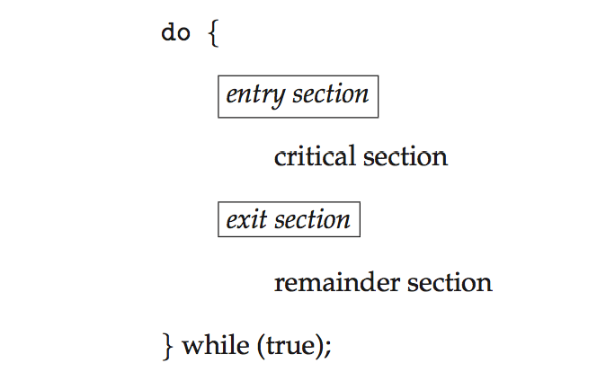
Critical Section
General structure of process p_{i} is

Slide 14
Solution to Critical-Section Problem
1. Mutual Exclusion 互斥 - If process P_{i} is executing in its critical section, then no other processes can be executing in their critical sections
2. Progress 前进 - If no process is executing in its critical section and there exist some processes that wish to enter their critical section, then the selection of the processes that will enter the critical section next cannot be postponed indefinitely

Slide 15
Solution to Critical-Section Problem
3. Bounded Waiting 有限等待 - A bound must exist on the number of times that other processes are allowed to enter their critical sections after a process has made a request to enter its critical section and before that request is granted
Assume that each process executes at a nonzero speed
No assumption concerning relative speed of the n processes

Slide 16
Solution to Critical-Section Problem
Two approaches depending on if kernel is preemptive or non-preemptive
Preemptive – allows preemption of process when running in kernel mode
Non-preemptive – runs until exits kernel mode, blocks, or voluntarily yields CPU
Essentially free of race conditions in kernel mode

Slide 17
Peterson’s Solution
Good algorithmic description of solving the problem
Two process solution
Assume that the load and store instructions are atomic; that is, cannot be interrupted
The two processes share two variables:
int turn;
Boolean flag[2]
The variable turn indicates whose turn it is to enter the critical section
The flag array is used to indicate if a process is ready to enter the critical section. flag[i] = true implies that process P_{i} is ready!

Slide 18
Algorithm for Process P_{i}
do {
flag[i] = true;
turn = j;
while (flag[j] && turn == j);
critical section
flag[i] = false;
remainder section
} while (true);
Provable that
Mutual exclusion is preserved
Progress requirement is satisfied
Bounded-waiting requirement is met

Slide 19
Synchronization Hardware
Many systems provide hardware support for critical section code
All solutions below based on idea of locking
Protecting critical regions via locks
Uniprocessors – could disable interrupts
Currently running code would execute without preemption
Generally too inefficient on multiprocessor systems
Operating systems using this not broadly scalable

Slide 20
Synchronization Hardware
Modern machines provide special atomic hardware instructions
Atomic 原子 = non-interruptible
Either test memory word and set value
Or swap contents of two memory words

Slide 21
Solution to Critical-section Problem Using Locks
do {
acquire lock
critical section
release lock
remainder section
} while (TRUE);

Slide 22
test_and_set Instruction
Definition:
boolean test_and_set (boolean *target)
{
boolean rv = *target;
*target = TRUE;
return rv:
}

Slide 23
Solution using test_and_set()
Shared boolean variable lock, initialized to FALSE
Solution:
do { while (test_and_set(&lock))
; /* do nothing */
/* critical section */
lock = false;
/* remainder section */
} while (true);

Slide 24
swap Instruction
Definition:
void Swap (boolean *a, boolean *b)
{
boolean temp = *a;
*a = *b;
*b = temp:
}

Slide 25
Solution using swap
Shared Boolean variable lock initialized to FALSE; Each process has a local Boolean variable key.
Solution:
while (true) {
key = TRUE;
while ( key == TRUE)
Swap (&lock, &key );
// critical section
lock = FALSE;
// remainder section
}

Slide 26
Bounded-waiting Mutual Exclusion with test_and_set
do { waiting[i] = true; key = true; while (waiting[i] && key)
key = test_and_set(&lock);
waiting[i] = false;
/* critical section */
…

Slide 27
Bounded-waiting Mutual Exclusion with test_and_set
/* critical section */
j = (i + 1) % n;
while ((j != i) && !waiting[j])
j = (j + 1) % n;
if (j == i)
lock = false;
else
waiting[j] = false;
/* remainder section */
} while (true);

Slide 28
semaphore

Slide 29
Mutex Locks
Previous solutions are complicated and generally inaccessible to application programmers
OS designers build software tools to solve critical section problem
Simplest is mutex lock

Slide 30
Mutex Locks
Product critical regions with it by first acquire() a lock then release() it
Boolean variable indicating if lock is available or not
Calls to acquire() and release() must be atomic
Usually implemented via hardware atomic instructions
But this solution requires busy waiting
This lock therefore called a spinlock 自旋锁

Slide 31
acquire() and release()
acquire() { while (!available)
; /* busy wait */
available = false;
}
release() {
available = true;
}
do {
acquire lock
critical section
release lock
remainder section
} while (true);

Slide 32
Semaphore
Binary semaphore 二进制信号量 – integer value can range only between 0 and 1
Then a mutex lock
Counting semaphore 计数信号量 – integer value can range over an unrestricted domain
Can implement a counting semaphore S as a binary semaphore
Can solve various synchronization problems

Slide 33
Semaphore
Two standard operations modify S: wait() and signal()
Originally called P() and V()
Can only be accessed via two indivisible (atomic) operations
wait (S) {
while (S <= 0)
; // busy wait
S--;
}
signal (S) {
S++;
}

Slide 34
Semaphore Usage
Consider P₁ and P₂ that require S₁ to happen before S₂
P1:
S₁;
signal(synch);
P2:
wait(synch);
S₂;

Slide 35
Semaphore Implementation
Must guarantee that no two processes can execute wait() and signal() on the same semaphore at the same time
Thus, implementation becomes the critical section problem where the wait and signal code are placed in the critical section
Could now have busy waiting in critical section implementation
But implementation code is short
Little busy waiting if critical section rarely occupied
Note that applications may spend lots of time in critical sections and therefore this is not a good solution

Slide 36
Semaphore Implementation with no Busy waiting
With each semaphore there is an associated waiting queue
Each entry in a waiting queue has two data items:
value (of type integer)
pointer to next record in the list
Two operations:
block – place the process invoking the operation on the appropriate waiting queue
wakeup – remove one of processes in the waiting queue and place it in the ready queue

Slide 37
Semaphore Implementation with no Busy waiting (Cont.)
typedef struct{
int value;
struct process *list;
} semaphore;
wait(semaphore *S) {
S->value--;
if (S->value < 0) { add this process to S->list;
block();
}
}

Slide 38
Semaphore Implementation with no Busy waiting (Cont.)
signal(semaphore *S) {
S->value++;
if (S->value <= 0) { remove a process P from S->list;
wakeup(P);
}
}

Slide 39
Deadlock and starvation

Slide 40
Deadlock and Starvation
Deadlock 死锁 – two or more processes are waiting indefinitely for an event that can be caused by only one of the waiting processes
Let S and Q be two semaphores initialized to 1
P₀ P₁
wait(S); wait(Q);
wait(Q); wait(S);
. .
signal(S); signal(Q);
signal(Q); signal(S);

Slide 41
Deadlock and Starvation
Starvation – indefinite blocking 无限期阻塞
A process may never be removed from the semaphore queue in which it is suspended

Slide 42
Classical problem of synchronization

Slide 43
Classical Problems of Synchronization
Classical problems used to test newly-proposed synchronization schemes
Bounded-Buffer Problem 有限缓冲问题
Readers and Writers Problem 读者-写者问题
Dining-Philosophers Problem 哲学家进餐问题

Slide 45
Bounded buffer problem

Slide 46
Bounded-Buffer Problem
n buffers, each can hold one item
Semaphore mutex initialized to the value 1
Semaphore full initialized to the value 0
Semaphore empty initialized to the value n

Slide 47
Bounded Buffer Problem (Cont.)
The structure of the producer process
do {
/* produce an item in next_produced */
wait(empty);
wait(mutex);
/* add next produced to the buffer */
signal(mutex);
signal(full);
} while (true);

Slide 48
Bounded Buffer Problem (Cont.)
The structure of the consumer process
do {
wait(full);
wait(mutex);
/* remove an item from buffer to next_consumed */
signal(mutex);
signal(empty);
/* consume the item in next consumed */
} while (true);

Slide 49
Readers-writers problem

Slide 50
Readers-Writers Problem
A data set is shared among a number of concurrent processes
Readers – only read the data set; they do not perform any updates
Writers – can both read and write
Problem – allow multiple readers to read at the same time
Only one single writer can access the shared data at the same time

Slide 51
Readers-Writers Problem Variations
Several variations of how readers and writers are treated – all involve priorities
First variation – no reader kept waiting unless writer has permission to use shared object
Second variation – once writer is ready, it performs write ASAP
Both may have starvation leading to even more variations
Problem is solved on some systems by kernel providing reader-writer locks

Slide 52
Readers-Writers Problem (cont.)
Shared Data
Data set
Semaphore wrt initialized to 1
Semaphore mutex initialized to 1
Integer read_count initialized to 0

Slide 53
Readers-Writers Problem (Cont.)
The structure of a writer process
do { wait(wrt);
... /* writing is performed */
...
signal(wrt);
} while (true);

Slide 54
Readers-Writers Problem (Cont.)
The structure of a reader process
do { wait(mutex); read_count++; if (read_count == 1)
wait(wrt);
signal(mutex);
...
/* reading is performed */
...
wait(mutex); read_count--; if (read_count == 0) signal(wrt); signal(mutex);
} while (true);

Slide 55
Dining-philosophers problem

Slide 56
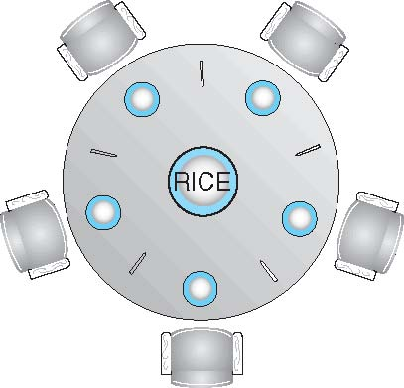
Dining-Philosophers Problem
Philosophers spend their lives thinking and eating
Don’t interact with their neighbors, occasionally try to pick up 2 chopsticks (one at a time) to eat from bowl
Need both to eat, then release both when done
In the case of 5 philosophers
Shared data
Bowl of rice (data set)
Semaphore chopstick [5] initialized to 1

Slide 57
Dining-Philosophers Problem Algorithm
The structure of Philosopher i:
do {
wait (chopstick[i] );
wait (chopStick[ (i + 1) % 5] );
// eat
signal (chopstick[i] );
signal (chopstick[ (i + 1) % 5] );
// think
} while (TRUE);
What is the problem with this algorithm?

Slide 58
Monitors and conditional variables

Slide 59
Monitors
A high-level abstraction that provides a convenient and effective mechanism for process synchronization
Abstract data type, internal variables only accessible by code within the procedure
Only one process may be active within the monitor at a time

Slide 60
Monitors
But not powerful enough to model some synchronization schemes
monitor monitor-name{
// shared variable declarations
procedure P1 (…) { …. }
procedure Pn (…) {……}
Initialization code (…) { … }
}

Slide 61
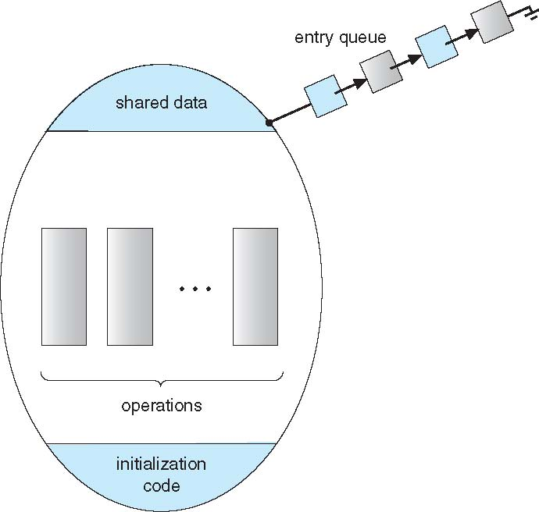
Schematic 示意 view of a Monitor

Slide 62
Solution to Dining Philosophers (Cont.)
Each philosopher i invokes the operations pickup() and putdown() in the following sequence:
DiningPhilosophers.pickup(i);
EAT
DiningPhilosophers.putdown(i);
No deadlock, but starvation is possible

Slide 63
Condition Variables
condition x, y;
Two operations on a condition variable:
x.wait() – a process that invokes the operation is suspended until x.signal()
x.signal() – resumes one of processes (if any) that invoked x.wait()
If no x.wait() on the variable, then it has no effect on the variable

Slide 64
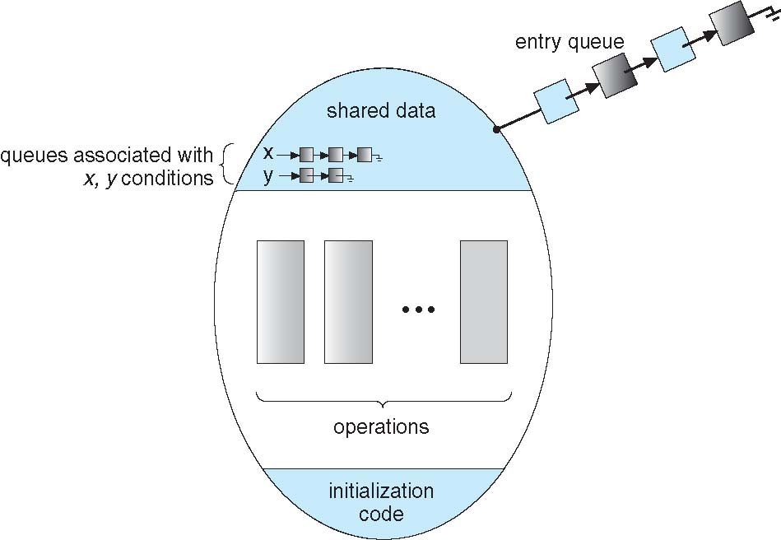
Monitor with Condition Variables

Slide 65
Solution to Dining Philosophers
monitor DiningPhilosophers{
enum {THINKING,HUNGRY,EATING) state[5];
condition self [5];
void pickup (int i) {
state[i] = HUNGRY;
test(i);
if (state[i] != EATING)
self[i].wait;
}
…

Slide 66
Solution to Dining Philosophers (cont.)
void putdown (int i) {
state[i] = THINKING;
// test left and right neighbors
test((i + 4) % 5);
test((i + 1) % 5);
}
…

Slide 67
Solution to Dining Philosophers (Cont.)
void test (int i) {
if ( (state[(i + 4) % 5] != EATING) &&
(state[i] == HUNGRY) &&
(state[(i + 1) % 5] != EATING) ) {
state[i] = EATING ;
self[i].signal () ;
}
}
…

Slide 68
Solution to Dining Philosophers (Cont.)
initialization_code() {
for (int i = 0; i < 5; i++)
state[i] = THINKING;
}
}

Slide 69
Condition Variables Choices
If process P invokes x.signal(), with Q in x.wait() state, what should happen next?
If Q is resumed, then P must wait

Slide 70
Condition Variables Choices
Options include
Signal and wait – P waits until Q leaves monitor or waits for another condition
Signal and continue – Q waits until P leaves the monitor or waits for another condition
Both have pros and cons – language implementer can decide
Monitors implemented in Concurrent Pascal compromise
P executing signal immediately leaves the monitor, Q is resumed
Implemented in other languages including Mesa, C#, Java

Slide 71
Monitor Implementation Using Semaphores
Variables
semaphore mutex; // (initially = 1)
semaphore next; // (initially = 0)
int next_count = 0;
Each procedure F will be replaced by
wait(mutex);
…
body of F;
…
if (next_count > 0)
signal(next)
else
signal(mutex);
Mutual exclusion within a monitor is ensured

Slide 72
Monitor Implementation – Condition Variables
For each condition variable x, we have:
semaphore x_sem; // (initially = 0)
int x_count = 0;
The operation x.wait can be implemented as:
x_count++;
if (next_count > 0)
signal(next);
else
signal(mutex);
wait(x_sem);
x_count--;

Slide 73
Monitor Implementation (Cont.)
The operation x.signal can be implemented as:
if (x_count > 0) {
next_count++;
signal(x_sem);
wait(next);
next_count--;
}

Slide 74
Resuming Processes within a Monitor
If several processes queued on condition x, and x.signal() executed, which should be resumed?
FCFS frequently not adequate
conditional-wait 条件等待 construct of the form x.wait(c)
Where c is priority number
Process with lowest number (highest priority) is scheduled next

Slide 75
A Monitor to Allocate Single Resource
monitor ResourceAllocator
{
boolean busy;
condition x;
void acquire(int time) {
if (busy)
x.wait(time);
busy = TRUE;
}
…
void release() {
busy = FALSE;
x.signal();
}
initialization code() {
busy = FALSE;
}
}

Slide 76
Synchronization examples

Slide 77
Synchronization Examples
Solaris
Windows XP
Linux
Pthreads

Slide 78
Solaris Synchronization
Implements a variety of locks to support multitasking, multithreading (including real-time threads), and multiprocessing
Uses adaptive mutexes 适应互斥 for efficiency when protecting data from short code segments
Starts as a standard semaphore spin-lock
If lock held, and by a thread running on another CPU, spins
If lock held by non-run-state thread, block and sleep waiting for signal of lock being released

Slide 79
Solaris Synchronization
Uses condition variables
Uses readers-writers locks when longer sections of code need access to data
Uses turnstiles 十字转门 to order the list of threads waiting to acquire either an adaptive mutex or reader-writer lock
Turnstiles are per-lock-holding-thread, not per-object
Priority-inheritance per-turnstile gives the running thread the highest of the priorities of the threads in its turnstile

Slide 80
Windows XP Synchronization
Uses interrupt masks to protect access to global resources on uniprocessor systems
Uses spinlocks on multiprocessor systems
Spinlocking-thread will never be preempted

Slide 81
Windows XP Synchronization
Also provides dispatcher objects 调度对象 user-land which may act mutexes, semaphores, events, and timers
Events
An event acts much like a condition variable
Timers notify one or more thread when time expired
Dispatcher objects either signaled-state (object available) or non-signaled state (thread will block)

Slide 82
Linux Synchronization
Linux:
Prior to kernel Version 2.6, disables interrupts to implement short critical sections
Version 2.6 and later, fully preemptive
Linux provides:
semaphores
spinlocks
reader-writer versions of both
On single-cpu system, spinlocks replaced by enabling and disabling kernel preemption

Slide 83
Pthreads Synchronization
Pthreads API is OS-independent
It provides:
mutex locks
condition variables
Non-portable extensions include:
read-write locks
spinlocks

Slide 84
Atomic transaction

Slide 85
Atomic Transactions 原子业务
System Model
Log-based Recovery
Checkpoints
Concurrent Atomic Transactions

Slide 86
System Model
Assures that operations happen as a single logical unit of work, in its entirety, or not at all
Related to field of database systems
Challenge is assuring atomicity despite computer system failures

Slide 87
System Model
Transaction - collection of instructions or operations that performs single logical function
Here we are concerned with changes to stable storage – disk
Transaction is series of read and write operations
Terminated by commit 提交 (transaction successful) or abort 撤销 (transaction failed) operation
Aborted transaction must be rolled back 回退 to undo any changes it performed

Slide 88
Types of Storage Media
Volatile storage – information stored here does not survive system crashes
Example: main memory, cache
Nonvolatile storage – Information usually survives crashes
Example: disk and tape
Stable storage – Information never lost
Not actually possible, so approximated via replication or RAID to devices with independent failure modes
Goal is to assure transaction atomicity where failures cause loss of information on volatile storage

Slide 89
Log-Based Recovery
Record to stable storage information about all modifications by a transaction
Most common is write-ahead logging
Log on stable storage, each log record describes single transaction write operation, including
Transaction name
Data item name
Old value
New value
<T_{i} starts> written to log when transaction T_{i} starts
<T_{i} commits> written when T_{i} commits
Log entry must reach stable storage before operation on data occurs

Slide 90
Log-Based Recovery Algorithm
Using the log, system can handle any volatile memory errors
Undo(T_{i}) restores value of all data updated by T_{i}
Redo(T_{i}) sets values of all data in transaction T_{i} to new values
Undo(T_{i}) and redo(T_{i}) must be idempotent 幂等
Multiple executions must have the same result as one execution
If system fails, restore state of all updated data via log
If log contains <T_{i} starts> without <T_{i} commits>, undo(T_{i})
If log contains <T_{i} starts> and <T_{i} commits>, redo(T_{i})

Slide 91
Checkpoints
Log could become long, and recovery could take long
Checkpoints shorten log and recovery time.
Checkpoint scheme:
Output all log records currently in volatile storage to stable storage
Output all modified data from volatile to stable storage
Output a log record <checkpoint> to the log on stable storage
Now recovery only includes Ti, such that Ti started executing before the most recent checkpoint, and all transactions after Ti All other transactions already on stable storage

Slide 92
Concurrent Transactions
Must be equivalent to serial execution – serializability 串行化
Could perform all transactions in critical section
Inefficient, too restrictive
Concurrency-control algorithms 并发控制算法 provide serializability

Slide 93
Serializability
Consider two data items A and B
Consider Transactions T₀ and T₁
Execute T₀, T₁ atomically
Execution sequence called schedule
Atomically executed transaction order called serial schedule
For N transactions, there are N! valid serial schedules

Slide 94
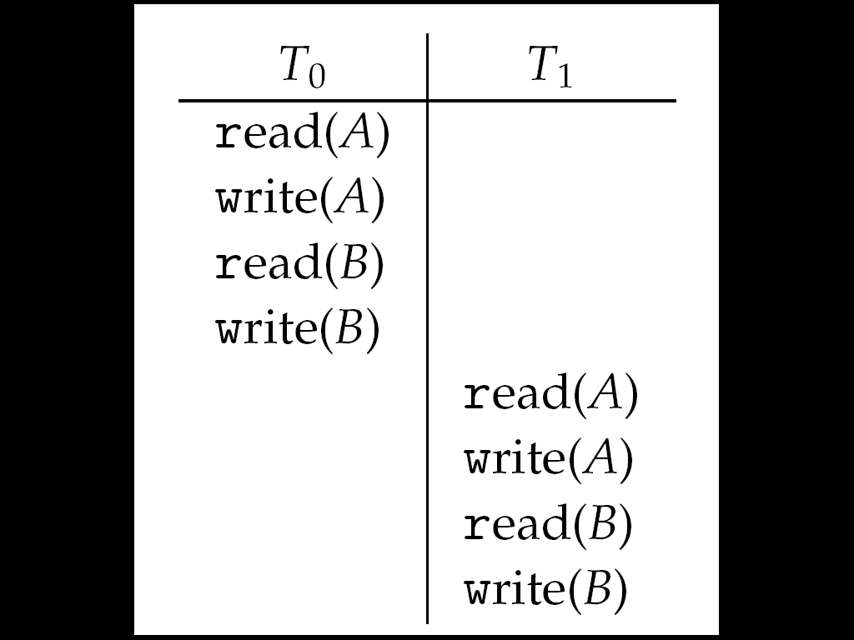
Schedule 1: T₀ then T₁

Slide 95
Nonserial Schedule
Nonserial schedule allows overlapped execute
Resulting execution not necessarily incorrect
Consider schedule S, operations O_{i}, O_{j}
Conflict if access same data item, with at least one write
If O_{i}, O_{j} consecutive and operations of different transactions & O_{i} and O_{j} don’t conflict
Then S’ with swapped order O_{j} O_{i} equivalent to S
If S can become S’ via swapping nonconflicting operations
S is conflict serializable

Slide 96
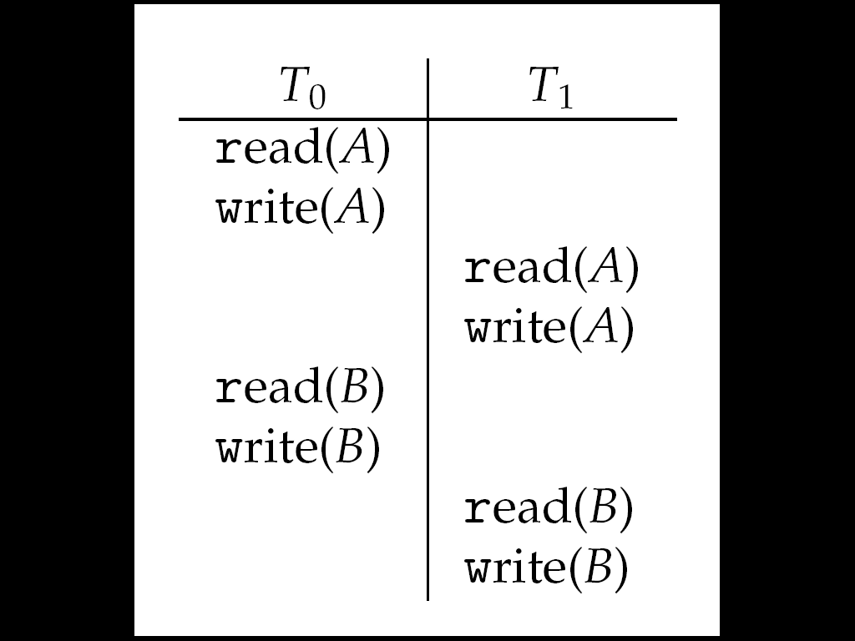
Schedule 2: Concurrent Serializable Schedule

Slide 97
Locking Protocol
Ensure serializability by associating lock with each data item
Follow locking protocol for access control
Locks
Shared – T_{i} has shared-mode lock (S) on item Q, T_{i} can read Q but not write Q
Exclusive – Ti has exclusive-mode lock (X) on Q, T_{i} can read and write Q
Require every transaction on item Q acquire appropriate lock
If lock already held, new request may have to wait
Similar to readers-writers algorithm

Slide 98
Two-phase Locking Protocol
Generally ensures conflict serializability
Each transaction issues lock and unlock requests in two phases
Growing – obtaining locks
Shrinking – releasing locks
Does not prevent deadlock

Slide 99
Timestamp-based Protocols
Select order among transactions in advance – timestamp-ordering
Transaction T_{i} associated with timestamp TS(T_{i}) before T_{i} starts
TS(T_{i}) < TS(T_{j}) if Ti entered system before T_{j}
TS can be generated from system clock or as logical counter incremented at each entry of transaction
Timestamps determine serializability order
If TS(T_{i}) < TS(T_{j}), system must ensure produced schedule equivalent to serial schedule where T_{i} appears before T_{j}

Slide 100
Timestamp-based Protocol Implementation
Data item Q gets two timestamps
W-timestamp(Q) – largest timestamp of any transaction that executed write(Q) successfully
R-timestamp(Q) – largest timestamp of successful read(Q)
Updated whenever read(Q) or write(Q) executed

Slide 101
Timestamp-based Protocol Implementation
Timestamp-ordering protocol assures any conflicting read and write executed in timestamp order
Suppose Ti executes read(Q)
If TS(T_{i}) < W-timestamp(Q), Ti needs to read value of Q that was already overwritten
read operation rejected and T_{i} rolled back
If TS(T_{i}) ≥ W-timestamp(Q)
read executed, R-timestamp(Q) set to max(R-timestamp(Q), TS(T_{i}))

Slide 102
Timestamp-ordering Protocol
Suppose Ti executes write(Q)
If TS(T_{i}) < R-timestamp(Q), value Q produced by T_{i} was needed previously and T_{i} assumed it would never be produced
Write operation rejected, T_{i} rolled back
If TS(T_{i}) < W-timestamp(Q), T_{i} attempting to write obsolete value of Q
Write operation rejected and T_{i} rolled back
Otherwise, write executed

Slide 103
Timestamp-ordering Protocol
Any rolled back transaction T_{i} is assigned new timestamp and restarted
Algorithm ensures conflict serializability and freedom from deadlock

Slide 104
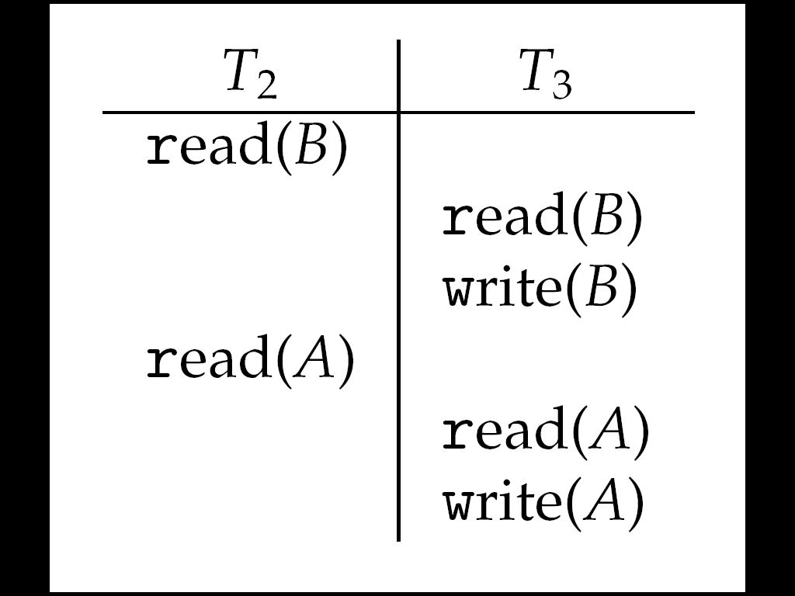
Schedule Possible Under Timestamp Protocol

Slide 105
The Sleeping Barber Problem
N chairs
1 barber
The barber: Sleep / Cut hair
The customers: Awake the barber / Cut hair / Wait / Leave

Slide 106
End of Chapter 6

